Slide 1


KGiSL Institute of Technology
(Approved by AICTE, New Delhi; Affiliated to Anna University, Chennai)
Recognized by UGC, Accredited by NBA (IT)
365, KGiSL Campus, Thudiyalur Road, Saravanampatti, Coimbatore – 641035.
HR MINI ASSISTANT BOT USING RPA TECHNOLOGY
BAVADHARNI T - 711719205011
NAREN KRISHNA NAG - 711719205031
SAMUEL V - 711719205045
SANTHIYA S - 711719205046
Mr. Mani Deepak Choudhry M.E.,(Ph,D)
Assistant Professor

Slide 2
Abstract
HR Mini Assistant Bot is a tool designed to automate and streamline HR management tasks. With features such as automated calendar management, virtual meeting scheduling, and data collection from resumes, this bot can save HR managers time and effort. The bot's ability to send bulk messages through WhatsApp and work with different video conferencing platforms makes it easier to communicate with employees and candidates.
It generates the Appointment and Relieving letter. Additionally, the bot includes a Voice Assistant and supports multiple languages, making it more accessible for a wider range of users.
By providing a faster, easier, and safer way to perform HR tasks, the HR Mini Assistant Bot has the potential to greatly enhance HR efficiency and productivity.
It has log file to track both the Bot and the HR. It reduces the computation time so carbon footprints is also reduced.

Slide 3
Introduction
Human resources management involves a wide range of tasks, from scheduling interviews to generating appointment and relieving letters to communicating with employees. These tasks can be time-consuming and often require a significant amount of manual effort. Additionally, managing HR tasks manually can lead to errors and inconsistencies.
To address these challenges, we have developed the HR Mini Assistant Bot. This bot is designed to automate and streamline many of the tasks involved in HR management, providing a faster, easier, and safer way to perform these tasks.
With the HR Mini Assistant Bot, HR managers can save time and effort by automating processes such as scheduling interviews, generating letters, and collecting data from resumes.

Slide 4
Literature Review
Name of the Paper | Author | About the work | Advantage | Disadvantage
Robotic Process Automation in Human Resource Management Published on,2020 | Liang Liang Liang Han Hualin Liu | The challenges and limitations of implementing RPA in HRM, such as the need for technical expertise and the potential for job displacement. They emphasize the importance of organizational culture and leadership support in successfully implementing RPA in HRM, and highlight the need for careful planning and management to ensure that RPA implementation aligns with organizational goals and objectives | Improved accuracy it can reduce errors and inconsistencies in HR processes, such as payroll processing and compliance reporting, leading to greater accuracy and fewer compliance issues. | Security concerns the systems can potentially expose sensitive HR data to security risks, so it's important to have robust security measures in place.

Slide 5
Literature Review
Name of the Paper | Author | About the work | Advantage | Disadvantage
Robotic Process Automation (RPA) in Human Resource Management Published on,(2020). | Hanadi Al-Zeghayer Fatimah Alabdullah | The various applications of RPA in HRM, including recruitment and selection, onboarding, performance management, and payroll processing. They also identify key factors that can influence the success of RPA implementation in HRM, such as organizational culture and leadership support. | Enhanced employee experience: RPA can automate tasks such as onboarding and training, leading to a smoother and more positive experience for employees. | Initial investment and maintenance costs: Implementing and maintaining RPA systems can require significant upfront costs, including software and hardware costs, as well as ongoing maintenance and updates.

Slide 6
Literature Review
Name of the Paper | Author | About the work | Advantage | Disadvantage
Robotic Process Automation in Human Resources: A Systematic Literature Review Published on,2021. | Haritha Malapati R. B. V. Subramanyam | The various applications of RPA in HRM, including recruitment and selection, onboarding, performance management, and payroll processing. They also identify key factors that can influence the success of RPA implementation in HRM, such as organizational culture and leadership support. | Increased compliance this can help ensure that HR processes comply with relevant regulations and standards | Technical complexity: RPA systems can be complex and require technical expertise to implement and maintain.

Slide 7
Existing Method
There are some HR automation solutions available in the market that offer similar functionality to HR Mini Assistant Bot.
Work Fusion Smart Process Automation: This solution includes HR automation capabilities such as resume screening,offer letter generation.
Automation Anywhere HR Automation: This solution includes pre-built automation templates for HR processes such as resume screening, onboarding, and data management.
Kryon HR Automation: This solution includes features such as resume parsing, and data entry.
Manual Work: All the tasks done by humanas manually.
Problems is Existing Solution:
Time Efficiency
Cost
Not a complete Product, solves only minimal tasks.

Slide 8
Proposed System
We developed a bot (HR Mini Assistant) which can help and assist HR to perform their task(s) more faster, easier and in a safer way. Also includes Voice Assistant and Multi Language support.
Tasks to be performed by HR Mini Assistant Bot:
Tasks / Events gathering and adding (Automating Google calendar).
Creating meetings for both personal and interviews through Google meet, Zoom, Webex, MS Teams.
Generate Appointment letter.
Generate Relieving letter.
Collecting data from resume.
Send bulk messages through WhatsApp.
Work on Google drive (create folder, Upload folder / file, Share file with the link).

Slide 9
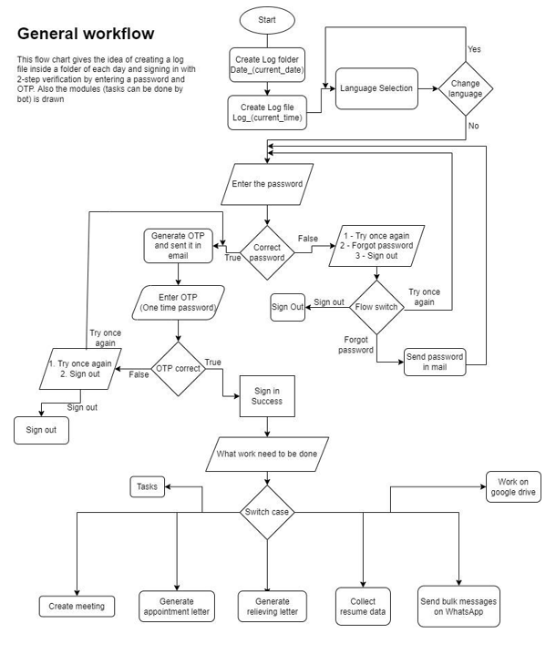
WORK FLOW

Slide 10
Module Description
LIST OF MODULES USED:
Create Online Meetings
Generate Appoinment Letters and Relieving Letters
Collection of Tasks from Google Calender
Resume Screening
Send Bulk messages On WhatsApp
Work on Google Drive

Slide 11
Module Description
CREATE ONLINE MEETINGS
Personal meeting
Platforms: Google meet, Zoom, Cisco WebEx, MS Teams.
Creates a meeting and sends the link to HR's mail or on WhatsApp
Interview meeting
Platform: Google meet
Creates meeting for each member in excel and sends the meeting link and meeting details like start time. end time, duration, etc, To their mail / in WhatsApp / Both mail and WhatsApp. / Just create meeting links
GENERATE APPOINMENT LETTER AND RELIVING LETTER
Generates Appointment Letters for each candidate in an excel sheet
Step 1: Save the file
Saves the appointment letter in .docx type (File Name :Enployee_name+"_Appintment_letter_"+("dd-mm-yyyy")+"_"+("hh-mm-ss").docx Saves the appointment letter in .pdf type (File Name :Enployee_name+"_Appintment_letter_"+("dd-mm-yyyy")+"_"+("hh-mm-ss").pdf

Slide 12
Module Description
Generates Relieving letters for each candidate in an excel sheet.
Step 1: Save the file
Saves the relieving letter in .docx type (File Name :
Candidate_name+Relieving_letter_"+("dd-mm-yyyy")+"_"+("hh-mm-ss").docx Saves the relieving letter in .pdf type (File Name :Candidate_name+Relieving_letter_"+("dd-mm-yyyy")+"_"+("hh-mm-ss").pdf
Step 2: Sends the Relieving letter pdf to their mail / WhatsApp / Both mail &WhatsApp

Slide 13
Module Description
RESUME SCREENING
Step 1: Collect resume document
Step 2: Digitize Document
Step 3: Classify Document Scope
Step 4: Collect the extracted data
Step 5: Store the collected data in excel.

Slide 14
Module Description
SEND BULK MESSAGES ON WHATSAPP
Step 1: Read the Text message that needs to be sent
Step 2: Read the numbers in the excel sheet
Step 3: Using the WhatsApp API Key, check whether the number is or not.
Step 4: Send a message
If it is a WhatsApp number send the text message to the number and write the number in a valid sheet in excel.
If it is not a WhatsApp number then write that number in an invalid sheet in excel.
Colour the number's cell in the main sheet

Slide 15
Module Description
WORK ON GOOGLE DRIVE
Create folder
Upload file
Upload folder

Slide 16
HARDWARE SOFTWARE REQUIREMENTS
HARDWARE REQUIREMENTS
Processor Intel(R) Core(TM) i5-1035G1 CPU @ 1.00GHz 1.19 GHz
Installed RAM 8.00 GB (7.77 GB usable)
System type 64-bit operating system, x64-based processor
SOFTWARE REQUIREMENTS
Ui Path (Robotics Process Automation)
SMTP
Ui Path Studio
Web API
AIML
Ui Path Orchestrator

Slide 17
CONCULSION
Time-saving : By automating repetitive and time-consuming HR tasks
Error reduction : Automated processes are less prone to errors than manual processes
Scalability : Your bot can scale up or down as needed to handle changing HR demands
Multi-language support : Bot can reach a wider audience and improve accessibility for non-native speakers.
Cost-effective : RPA is often more cost-effective than traditional IT solutions
Enhanced user experience : By including a voice assistant, your bot can provide a more natural and intuitive user experience
Reduce Carbon Footprints : Bot reduces the computation time.
Complete Product : HR Mini Assistant Bot is complete product not like the existing solutions. It is capable of doing 7+ tasks.

Slide 18
IMPLEMENTATION
https://drive.google.com/file/d/1RGbxFgJyFKEmktLLCEc6AsqJ0HK_i5gl/view?usp=sharing

Slide 19
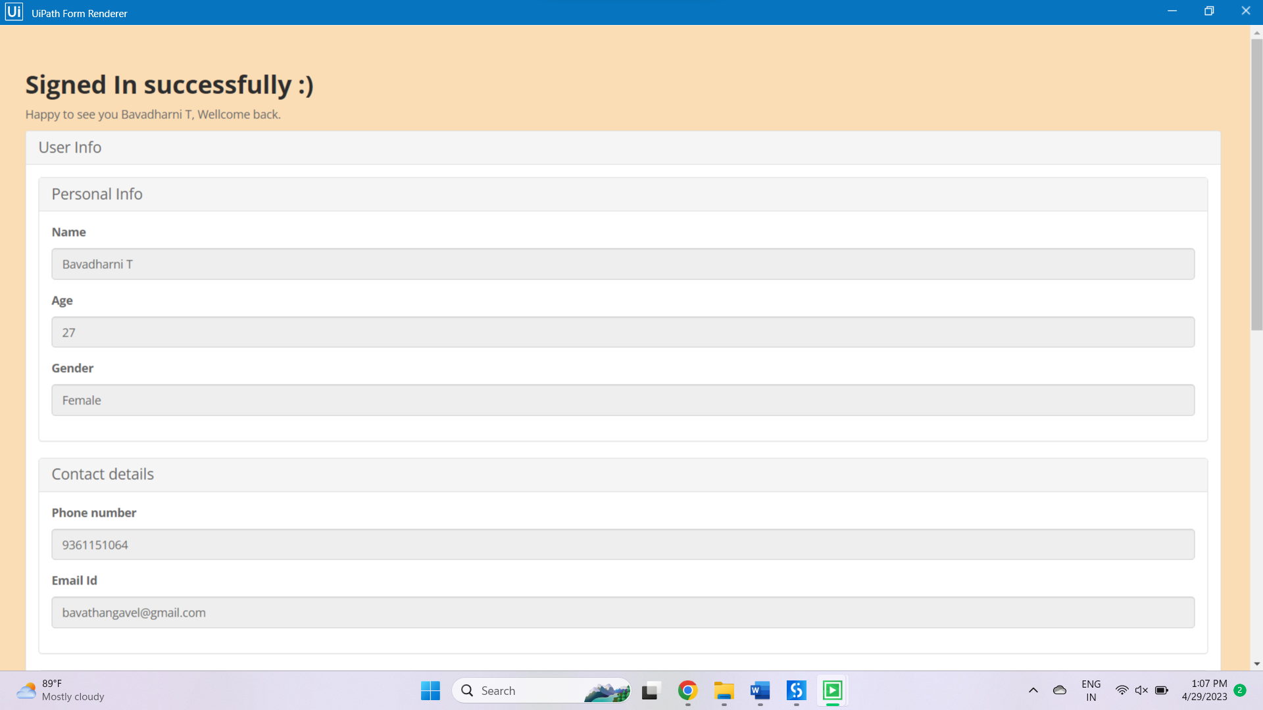
RESULT
Sign in

Slide 20
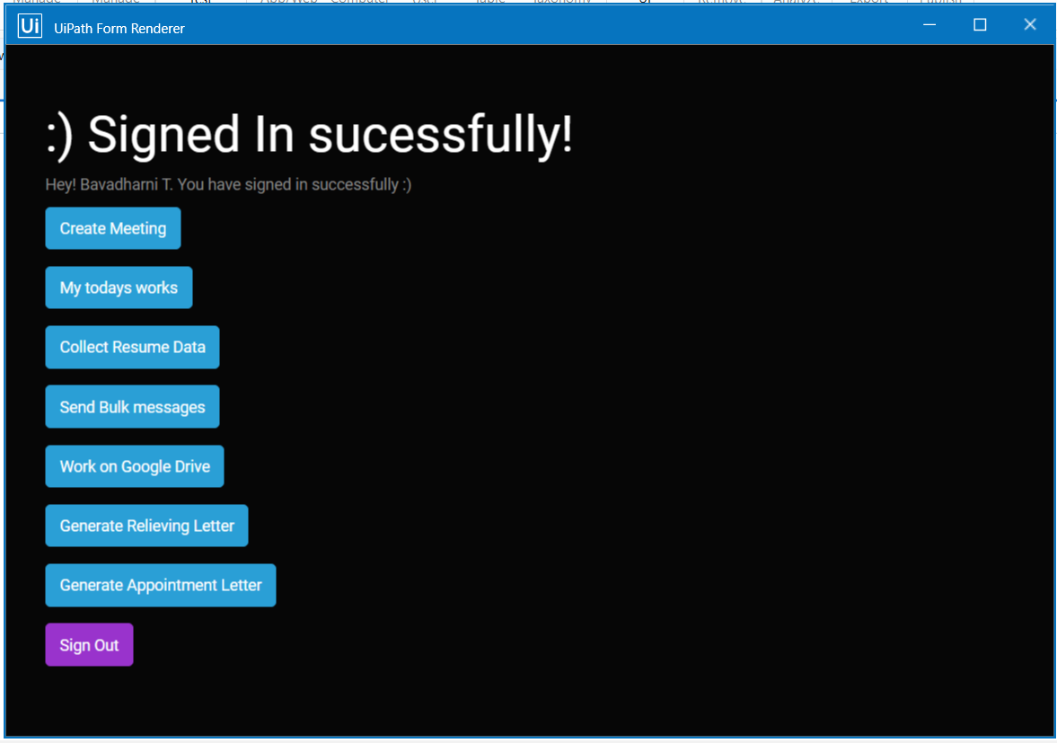

Slide 21
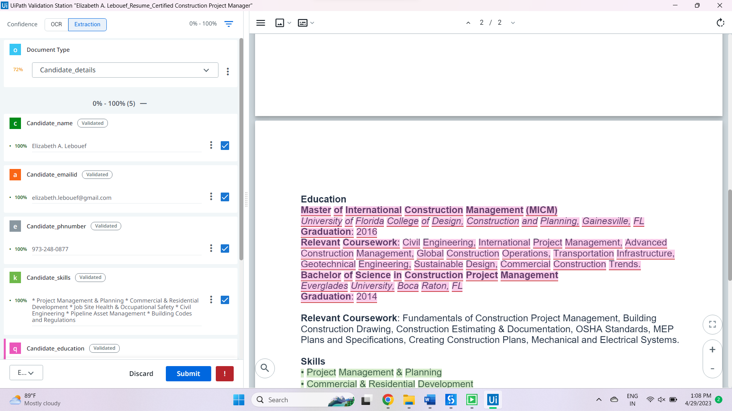
Resume Data collection

Slide 22
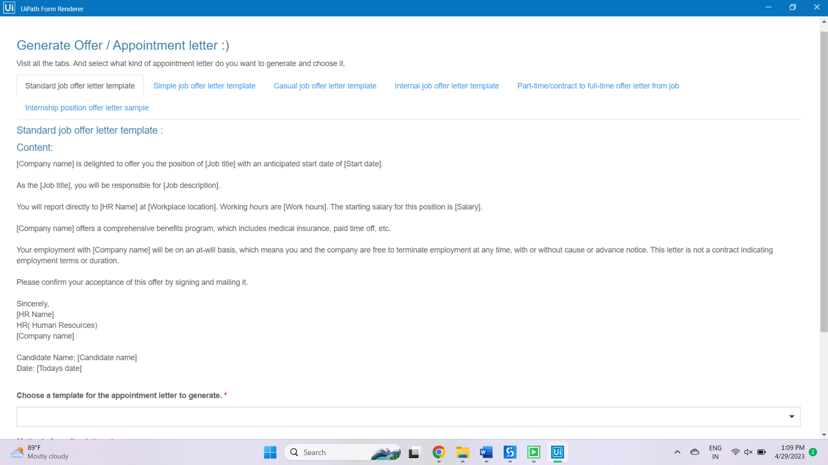
Appointment Letter Generation

Slide 23
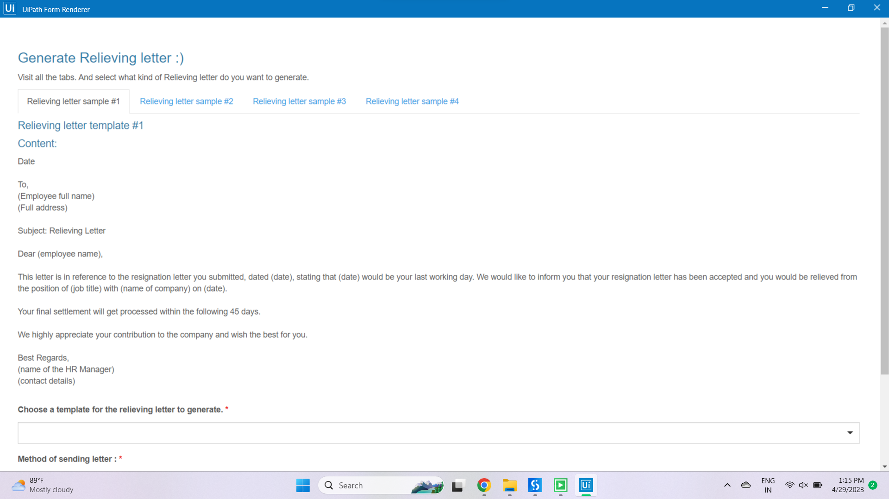
Relieving Letter Generation

Slide 24
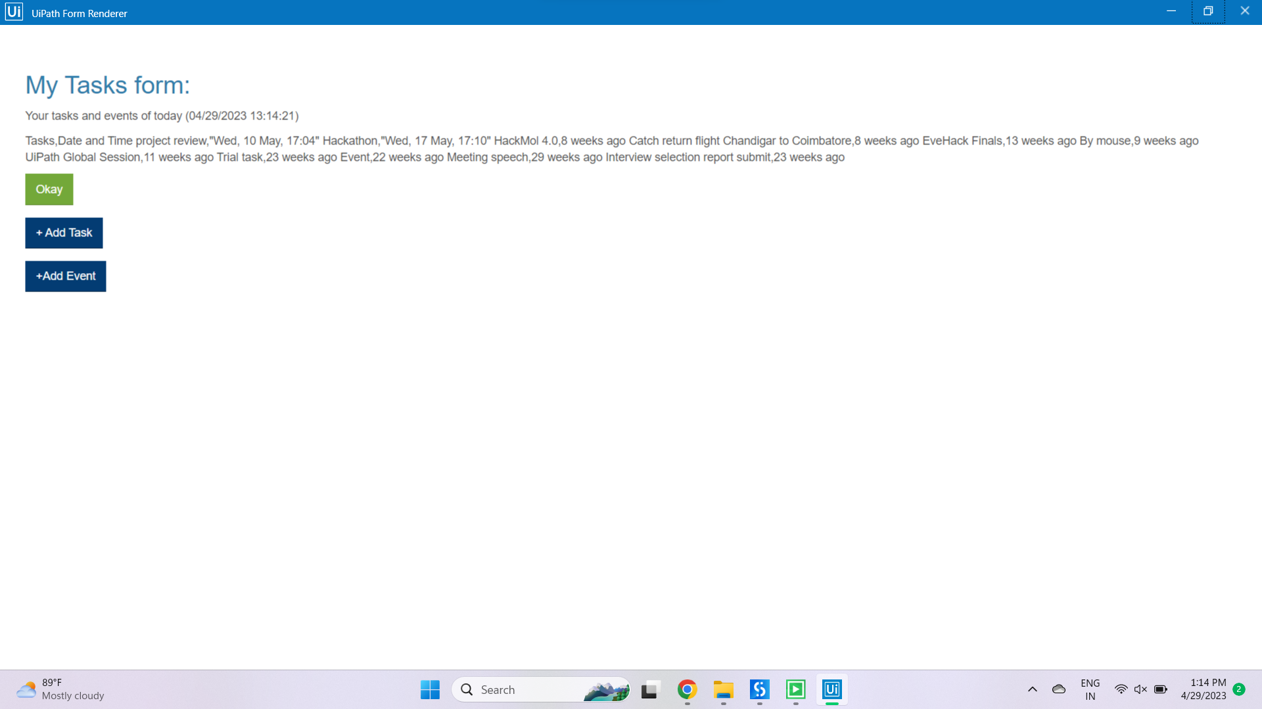
Collection of Tasks for Google Calender

Slide 25
References
[1] "Robotic Process Automation (RPA) in Human Resource Management: A Systematic Literature Review" by Hanadi Al-Zeghayer and Fatimah Alabdullah (2020).
[2] "Robotic Process Automation in Human Resource Management: A Literature Review" by Liang Liang, Liang Han, and Hualin Liu (2020).
[3] "Robotic Process Automation in Human Resources: A Literature Review and Research Agenda" by Petra Schubert, Christopher Rentrop, and Sabrina Duda (2019).
[4] "Robotic Process Automation in Human Resources: A Systematic Literature Review" by Haritha Malapati and R. B. V. Subramanyam (2021).
[5] Anusha N D, Baishali Rawat,Renuka J, Sahana S, Vijayshree H P RPA for Human Resource Operations, International Journal of Engineering Research & Technology (IJERT) ISSN: 2278-0181, Vol. 8 Issue 04, April-2019
[6] Ruchi Issac, Riva Muni Kenali Desai,Delinated , “Delinated Analysis of RPA tools”, Harvard Business Review Online June 2019.
[7] Liang Liang, Liang Han, Hualin Liu "Robotic Process Automation in Human Resource Management" on,2020.
[8] Aini Aman ,Fernandez, “RPA is transforming auditing and banking sector”,June 2018
[9] Hendrik Lund, Luilgi Palgrian , “The future of robotics technology”, April 2017.
[10] Miklos Andrea, Rozario , “RPA in transforming Accounting and Auditing”, June 2018, Journal Paper.

Slide 26
Thank You

